Slide 1



WORKFLOW MANAGEMENT SYSTEMS
Women in Workflow
TIVIDY
https://github.com/u21450481-art/214FinalProjectTIVIDY.git

Slide 2

OMEN IN WORKFLOW
Without a workflow system
With TIVIDY
What is a Workflow System
Definition
tasks, roles, rules
Work Request
creates
email
Instance
one live case
Role A
Role B
Task 2
Role A
Task 3
Role C
chat
spreadsheet
Task 2
Role B
Role C
History
every step recorded
Who is next?
Who approved this?
Where is it stuck?
routed to the right role, in order

Slide 3
OMEN IN WORKFLOW
WorkflowEngine
uses
Building a workflow
Builder: assemble the WorkflowDefinition
Prototype: run it
Director
WorkflowDefinition
directs
instantiates
builds
Facade - Builder - Prototype
WorkflowDefinitionBuilder
WorkflowInstance
CustomDefinitionBuilder
DataPayload

Slide 4
OMEN IN WORKFLOW
Tasks (Composite)
People (Composite)
WorkflowComponent
Participant
members
children
assignee
Structure
creates
Task
Subprocess
Employee
Department
Iterator - Composite
WorkflowIterator
depthFirstIterator
Traversal (Iterator)

Slide 5
OMEN IN WORKFLOW
Task lifecycle (State)
Stage
Lifecycles and Approvals
NotStarted
InProgress
Complete
Rejected
Cancelled
Approval chain (Chain of Responsibilty
next
ApprovalHandler
State - Chain of Responsibilty
handles
ManagerHandler
DirectorHandler
CEOHandler
ApprovalHandler

Slide 6
OMEN IN WORKFLOW
WorkflowOrchestrator
reports events
Coordination
EngineMediator
WorkflowComponent
assigns with
Mediator - Strategy
AssignmentStrategy
RoleBasedStrategy
LeastLoadedStrategy
MostExperiencedStrategy

Slide 7
OMEN IN WORKFLOW
EngineMediator
runs actions through
CommandHistory
Actions
stores
Command
Command
MacroCommand
StateTransitionCommand
AssignTaskCommand
RecordDecisionCommand
SetDataCommand
StartCommand
CompleteCommand
RejectCommand
CancelCommand

Slide 8
OMEN IN WORKFLOW
EngineMediator
imports data with
The outside world
DataAdapter
HrDataAdapter
ClaimsDataAdapter
ReturnsDataAdapter
wraps
wraps
wraps
Adapter
LegacyHrSystem
ClaimsSystem
ReturnsSystem

Slide 9
OMEN IN WORKFLOW
Retail Returns:
Check Receipt → Inspect Item → Approve Refund → Refund + Restock → Close
Insurance Claims:
Register Claim → Verify policy → Assess damage → Approve → Pay out → Close
One engine, two workflows

Slide 10
OMEN IN WORKFLOW
Testing &
Design Decisions

Slide 11
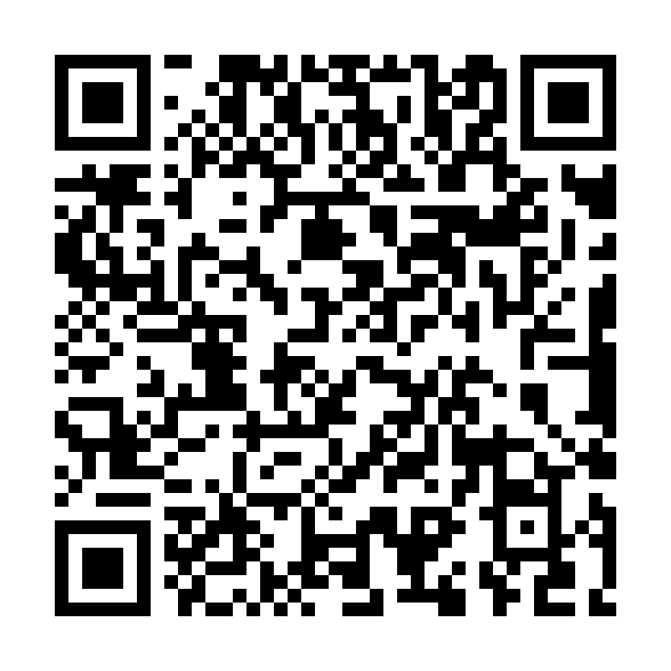
OMEN IN WORKFLOW
TSHEGOFATSO MAUTJANE
CARLA ERASMUS
LUTHANDO SHILHWAIO
VIMBAI CHIVUNGA
BOWDENE PILLAY

